Slide 1
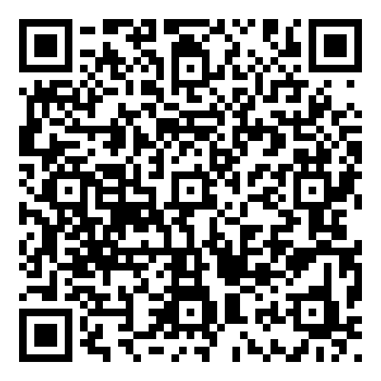
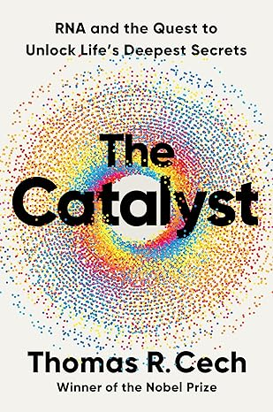
New Science Book Information from UNIV. CO-OP
The Catalyst:
RNA and the Quest to Unlock Life's Deepest Secrets
※大学生協洋書オンラインストアの該当商品のページへ
2024年6月
刊行
For over half a century, DNA has dominated science and the popular imagination as the “secret of life.” But over the last several decades, a quiet revolution has taken place. In a series of breathtaking discoveries, the biochemist Thomas R. Cech and a diverse cast of brilliant scientists have revealed that RNA—long overlooked as the passive servant of DNA—sits at the center of biology’s greatest mysteries: How did life begin? What makes us human? Why do we get sick and grow old? In The Catalyst, Cech finally brings together years of research to demonstrate that RNA is the true key to understanding life on Earth, from its very origins to our future in the twenty-first century.
A gripping journey of discovery, The Catalyst moves from the early experiments that first hinted at RNA’s spectacular powers, to Cech’s own paradigm-shifting finding that it can catalyze cellular reactions, to the cutting-edge biotechnologies poised to reshape our health. We learn how RNA—once thought merely to transmit DNA’s genetic instructions to the cell’s protein-making machinery—may have jump-started life itself, and how, at the same time, it can cut our individual lives short through viral diseases and cancer. We see how RNA is implicated in the aging process and explore the darker depths of the supposed fountain of youth, telomerase. And we catch a thrilling glimpse into how RNA-powered therapies—from CRISPR, the revolutionary tool that uses RNA to rewrite the code of life, to the groundbreaking mRNA vaccines that have saved millions during the pandemic, and more—may enable us to improve and even extend life beyond nature’s current limits.
Written by one of our foremost scientists, The Catalyst is a must-read guide to the present and future of biology and medicine.
●著者Cech, Tom
●出版社：W.W. Norton & Co., Inc.
●ISBN： 978-1-324-05068-1
●刊行：2024年6月
●hardcover/320 p.
●生化学・分子生物学・生理学
組合員価格は生協店舗にお尋ねください
＊海外からの仕入れのため為替レートの変動により価格は変動します。
研究費・科研費でのご購入は生協が便利で安心！
注文書
The Catalyst: RNA and the Quest to Unlock Life's Deepest Secrets ご注文 冊
氏名: TEL: お支払方法（○で囲む） 校費・私費
学部名； 学科名： 研究科or研究室名：
大学生協洋書オンラインストア:https://yosho.univcoop.jp/BookShop/
書籍ポータルサイト: https://online.univ.coop/book_front/
発行：2024年6月11日

